Slide 1
Statistical Techniques in Robotics
Sebastian Thrun & Alex Teichman
Stanford Artificial Intelligence Lab
Slide credits: Wolfram Burgard, Dieter Fox, Cyrill Stachniss, Giorgio Grisetti, Maren Bennewitz, Christian Plagemann, Dirk Haehnel, Mike Montemerlo, Nick Roy, Kai Arras, Patrick Pfaff and others
_x0016__x001a__x001a__x001a__x001a_

Slide 2
Course Staff
Lectures: Sebastian Thrun
  thrun@stanford.edu
CA: Alex Teichman, PhD Candidate
  teichman@stanford.edu_x0013_

Slide 3
Time and Location
200-203 (???)
M/W 9:30-10:45
Web: cs226.stanford.edu

Slide 4
Requirements
Warm-up assignments
written assignments (about 3)
research project (in teams), 30%
midterm, 30%

Slide 5
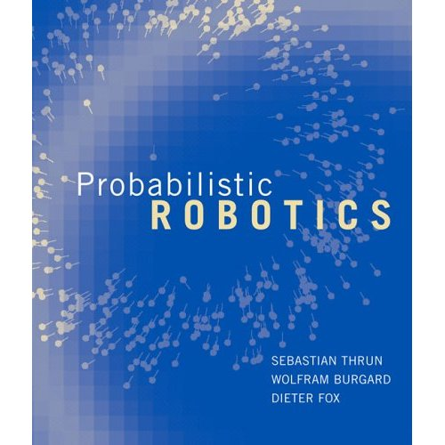
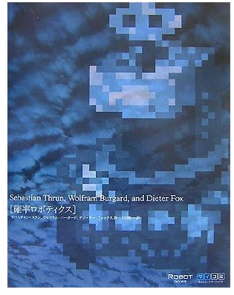
Text Book: Probabilistic Robotics

Slide 6
Goal of this course
Introduction to Contemporary Robotics
Provide an overview of problems / approaches in probabilistic robotics
Probabilistic reasoning: Dealing with noisy data
Some hands-on experience and exercises

Slide 7
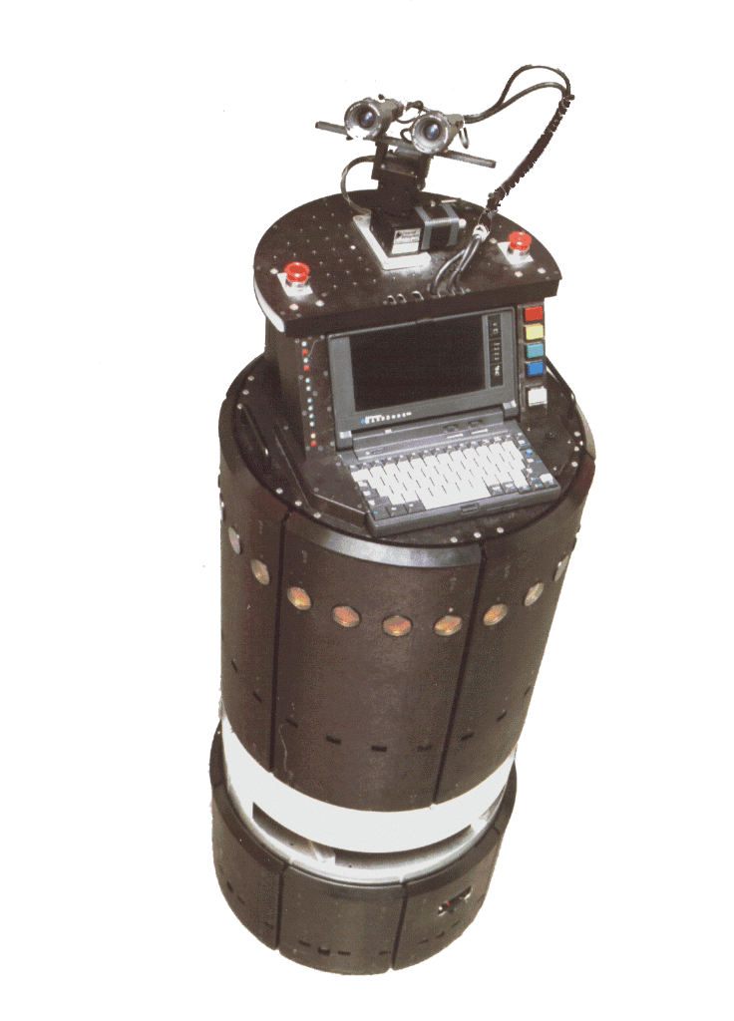
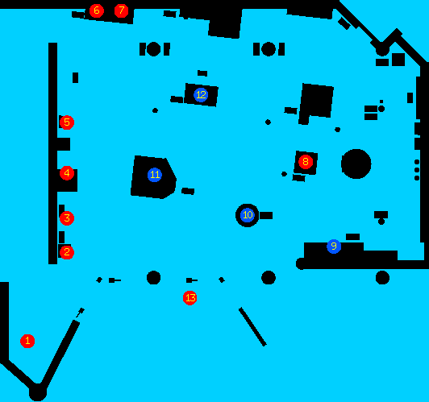
AI View on Mobile Robotics
Sensor data
Control system
World model
Actions

Slide 8
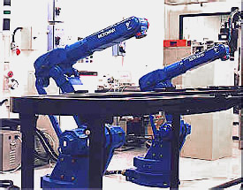
Robotics Yesterday

Slide 9
Current Trends in Robotics
Robots are moving away from factory floors to
  Entertainment, toys
  Personal services
  Medical, surgery
  Industrial automation
  (mining, harvesting, …)
  Hazardous environments
  (space, underwater)

Slide 10

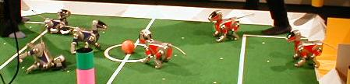
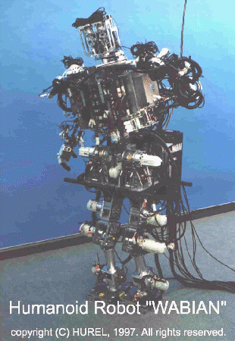
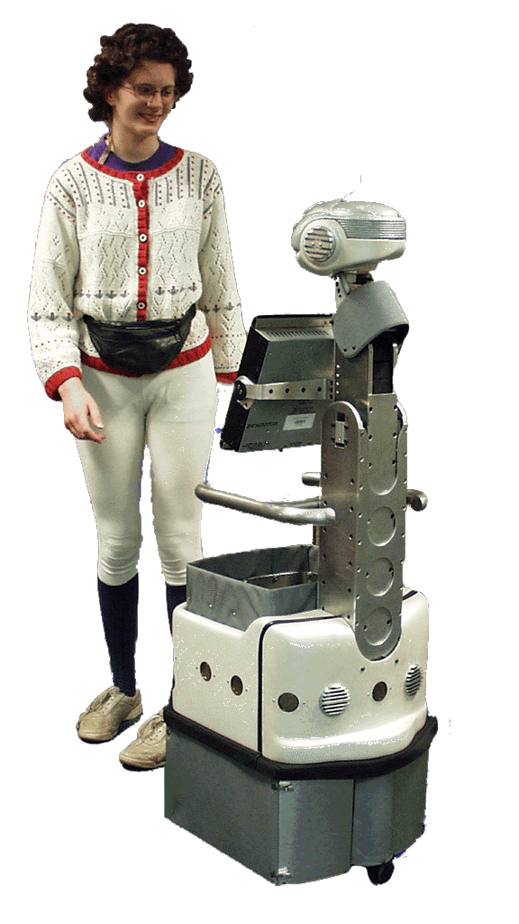
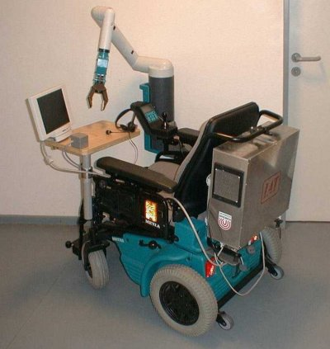
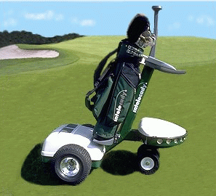
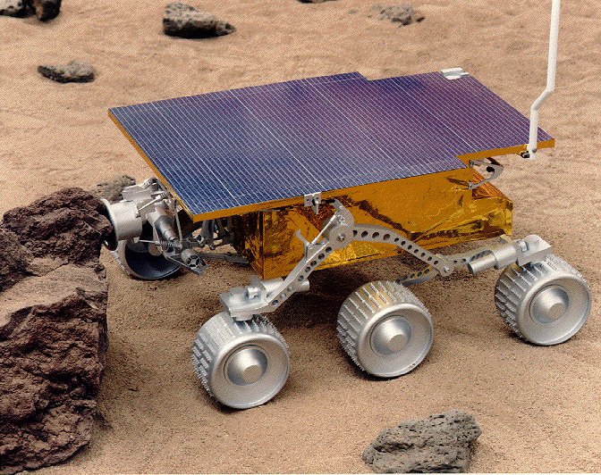
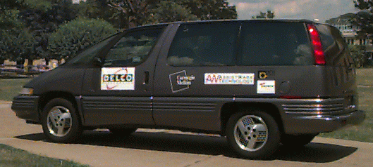
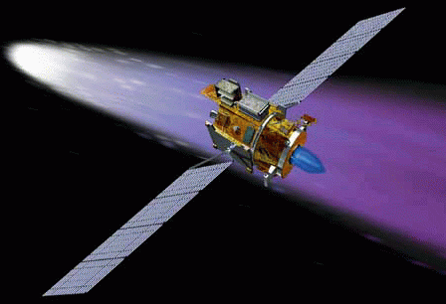
Robotics Today

Slide 11
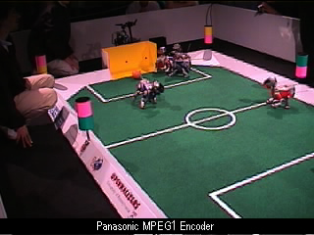
RoboCup-99, Stockholm, Sweden

Slide 12

Mobile Manipulation
[Brock et al., Robotics Lab, Stanford University, 2002]

Slide 13
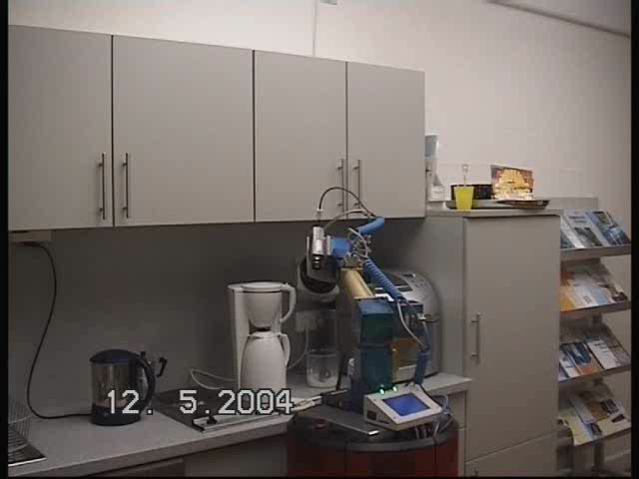
Mobile Manipulation

Slide 14
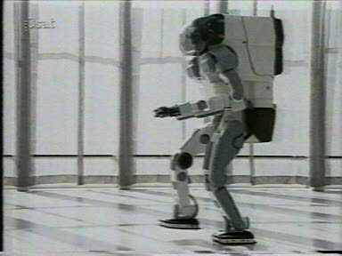
Humanoids: P2
Honda P2 ‘97

Slide 15
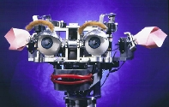
Emotional Robots: Cog & Kismet
[Brooks et al., MIT AI Lab, 1993-today]

Slide 16
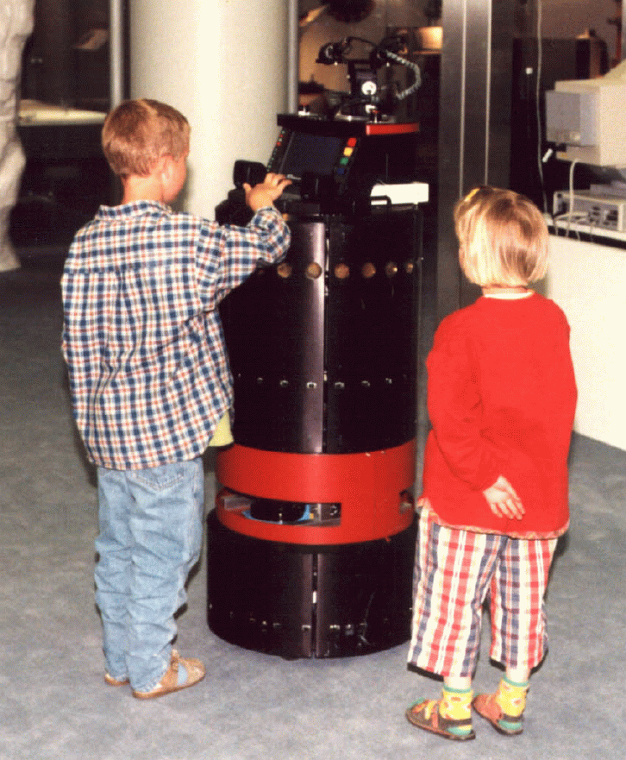
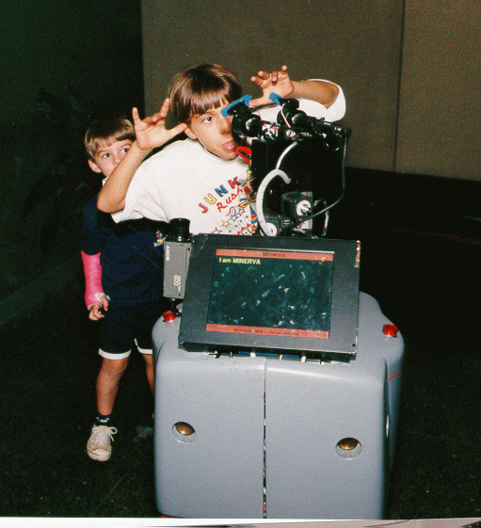
Brief Case Study:
Museum Tour-Guide Robots
Rhino, 1997
Minerva, 1998

Slide 17
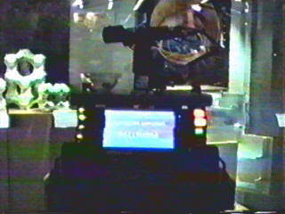
Rhino (Univ. Bonn + CMU, 1997)

Slide 18

Minerva (CMU + Univ. Bonn, 1998)
Minerva

Slide 19
Robot Paradigms

Slide 20
Robotics: General Background
Autonomous, automaton
  self-willed (Greek, auto+matos)
Robot
  Karel Capek in 1923 play R.U.R.
  (Rossum’s Universal Robots)
    labor (Czech or Polish, robota)
    workman (Czech or Polish, robotnik)

Slide 21
Asimov’s Three Laws of Robotics
A robot may not injure a human being, or, through inaction, allow a human being to come to harm.
A robot must obey the orders given it by human beings except when such orders would conflict with the first law.
A robot must protect its own existence as long as such protection does not conflict with the first or second law.
[Runaround, 1942]

Slide 22
Trends in Robotics Research
Classical Robotics (mid-70’s)
exact models
no sensing necessary
Reactive Paradigm (mid-80’s)
no models
relies heavily on good sensing
Hybrids (since 90’s)
model-based at higher levels
reactive at lower levels
Probabilistic Robotics (since mid-90’s)
seamless integration of models and sensing
inaccurate models, inaccurate sensors

Slide 23
Classical / Hierarchical Paradigm
Sense
Plan
Act
70’s
Focus on automated reasoning and knowledge representation
STRIPS (Stanford Research Institute Problem Solver): Perfect world model, closed world assumption
Find boxes and move them to designated position

Slide 24
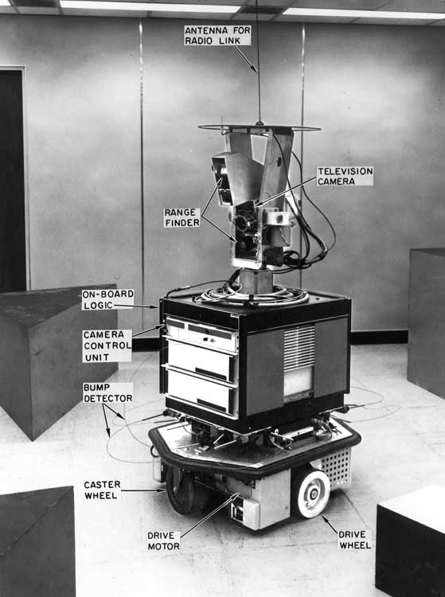
Shakey ‘69
Stanford Research Institute

Slide 25
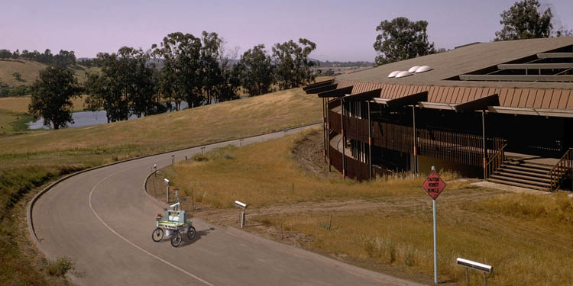
Stanford CART ‘73
Stanford AI Laboratory / CMU (Moravec)

Slide 26
Classical Paradigm
Stanford Cart
Take nine images of the environment, identify interesting points in one image, and use other images to obtain depth estimates.
Integrate information into global world model.
Correlate images with previous image set to estimate robot motion.
On basis of desired motion, estimated motion, and current estimate of environment, determine direction in which to move.
Execute the motion.

Slide 27
Trends in Robotics Research
Classical Robotics (mid-70’s)
exact models
no sensing necessary
Reactive Paradigm (mid-80’s)
no models
relies heavily on good sensing
Hybrids (since 90’s)
model-based at higher levels
reactive at lower levels
Probabilistic Robotics (since mid-90’s)
seamless integration of models and sensing
inaccurate models, inaccurate sensors

Slide 28
Reactive / Behavior-based Paradigm
Sense
Act
No models: The world is its own, best model
Easy successes, but also limitations
Investigate biological systems
Best-known advocate: Rodney Brooks (MIT)

Slide 29
Classical Paradigm as Horizontal/Functional Decomposition
Perception
Model
Plan
Execute
Motor Control
Sense
Plan
Act
Sensing
Action
Environment

Slide 30
Reactive Paradigm as
Vertical Decomposition
Build map
Explore
Wander
Avoid obstacles
Sensing
Action
Environment

Slide 31
Characteristics of Reactive Paradigm
Situated agent, robot is integral part of the world.
No memory, controlled by what is happening in the world.
Tight coupling between perception and action via behaviors.
Only local, behavior-specific sensing is permitted (ego-centric representation).

Slide 32
Behaviors
… are a direct mapping of sensory inputs to a pattern of motor actions that are then used to achieve a task.
… serve as the basic building block for robotics actions, and the overall behavior of the robot is emergent.
… support good software design principles due to modularity.

Slide 33
Subsumption Architecture
Introduced by Rodney Brooks ’86.
Behaviors are networks of sensing and acting modules (augmented finite state machines AFSM).
Modules are grouped into layers of competence.
Layers can subsume lower layers.
No internal state!

Slide 34
Level 0: Avoid
Polar plot of sonars
Feel force
Run away
Turn
force
heading
Sonar
polar
plot
heading
encoders
Collide
Forward
halt

Slide 35
Level 1: Wander
heading
Wander
Avoid
force
modified
heading
Feel force
Run away
s
Turn
force
heading
Sonar
polar
plot
heading
encoders
Collide
Forward
halt

Slide 36
Level 2: Follow Corridor
Stay in
middle
distance, direction traveled
Integrate
Look
heading
to middle
corridor
s
Wander
Avoid
force
modified
heading
Feel force
Run away
s
Turn
force
heading
Sonar
polar
plot
heading
encoders
Collide
Forward
halt

Slide 37
Potential Field Methodologies
Treat robot as particle acting under the influence of a potential field
Robot travels along the derivative of the potential
Field depends on obstacles, desired travel directions and targets
Resulting field (vector) is given by the summation of primitive fields
Strength of field may change with distance to obstacle/target

Slide 38
Primitive Potential Fields
Uniform
Perpendicular
Attractive
Repulsive
Tangential

Slide 39
Corridor following with Potential Fields
Level 0 (collision avoidance)
is done by the repulsive fields of detected obstacles.
Level 1 (wander)
adds a uniform field.
Level 2 (corridor following)
replaces the wander field by three fields (two perpendicular, one uniform).

Slide 40
Characteristics of Potential Fields
Suffer from local minima
  Backtracking
  Random motion to escape local minimum
  Procedural planner s.a. wall following
  Increase potential of visited regions
  Avoid local minima by harmonic functions
Goal

Slide 41
Characteristics of Potential Fields
No preference among layers
Easy to visualize
Easy to combine different fields
High update rates necessary
Parameter tuning important

Slide 42
Reactive Paradigm
Representations?
Good software engineering principles?
Easy to program?
Robustness?
Scalability?

Slide 43
Discussion
Imagine you want your robot to perform navigation tasks, which approach would you choose?
What are the benefits of the reactive (behavior-based) paradigm? How about the deliberate (planning) paradigm?
Which approaches will win in the long run?

Slide 44
Trends in Robotics Research
Classical Robotics (mid-70’s)
exact models
no sensing necessary
Reactive Paradigm (mid-80’s)
no models
relies heavily on good sensing
Hybrids (since 90’s)
model-based at higher levels
reactive at lower levels
Probabilistic Robotics (since mid-90’s)
seamless integration of models and sensing
inaccurate models, inaccurate sensors

Slide 45
Hybrid Deliberative/reactive Paradigm
Plan
Sense
Act
Combines advantages of previous paradigms
  World model used for planning
  Closed loop, reactive control

Slide 46
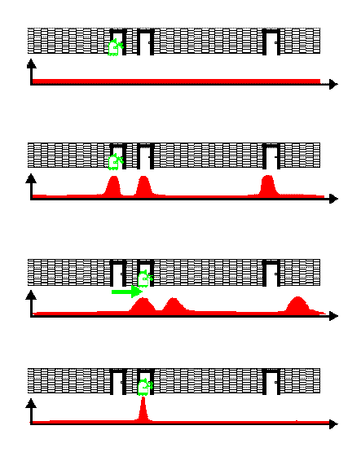
Probabilistic Robotics

